Slide 1
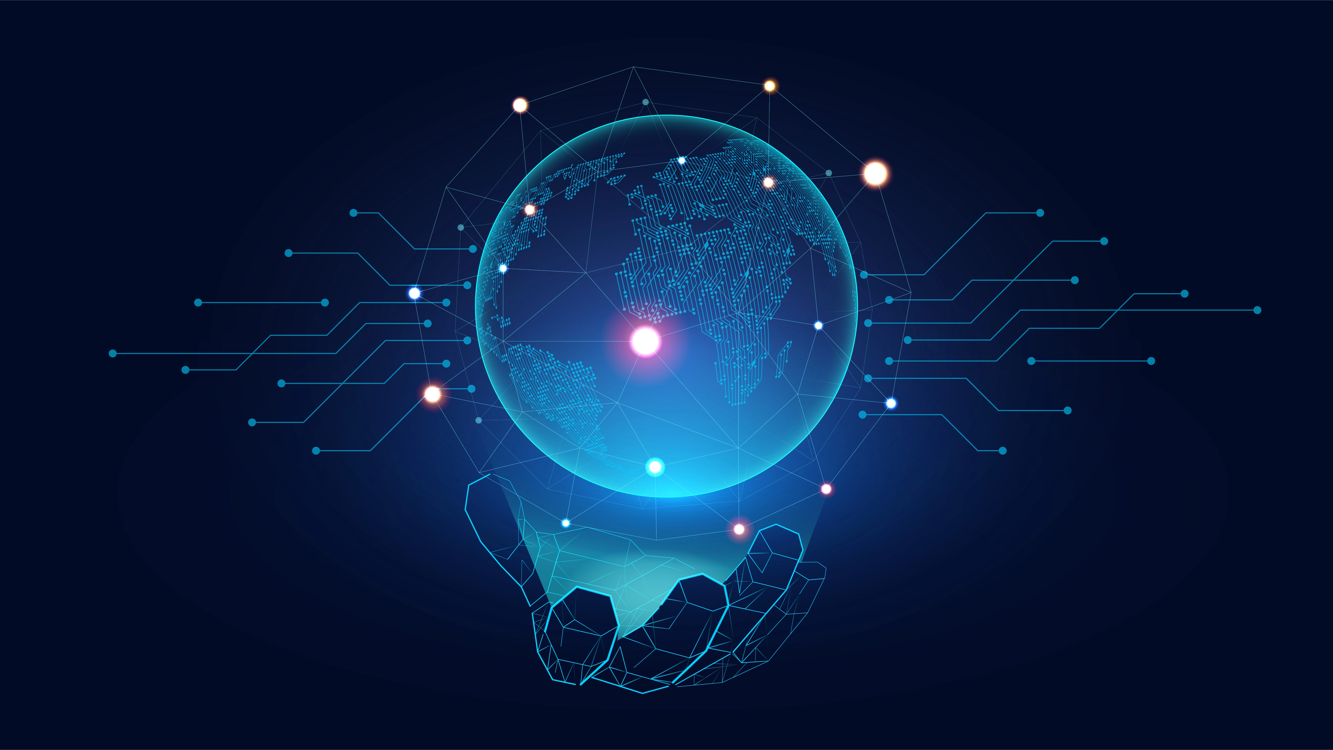
MAJI Chatbot
Kaung Min Sett
Vivek K. Maheshwari

Slide 2
What is an Artificial Intelligence(AI) chatbot?
An AI chatbot is a computer software simulating human-like discussions with people using artificial intelligence and natural language processing (NLP)
Customer service is one of the most common use cases for AI chatbots. They may offer automated support for standard questions and issues, freeing human agents to address more complicated or urgent requests
AI chatbots can also be applied to FAQ sections on websites, giving users speedy and precise responses to frequent questions. AI chatbots can also serve as personal assistants by setting up appointments, reminding users of important dates, and carrying out other repetitive activities on their behalf

Slide 3
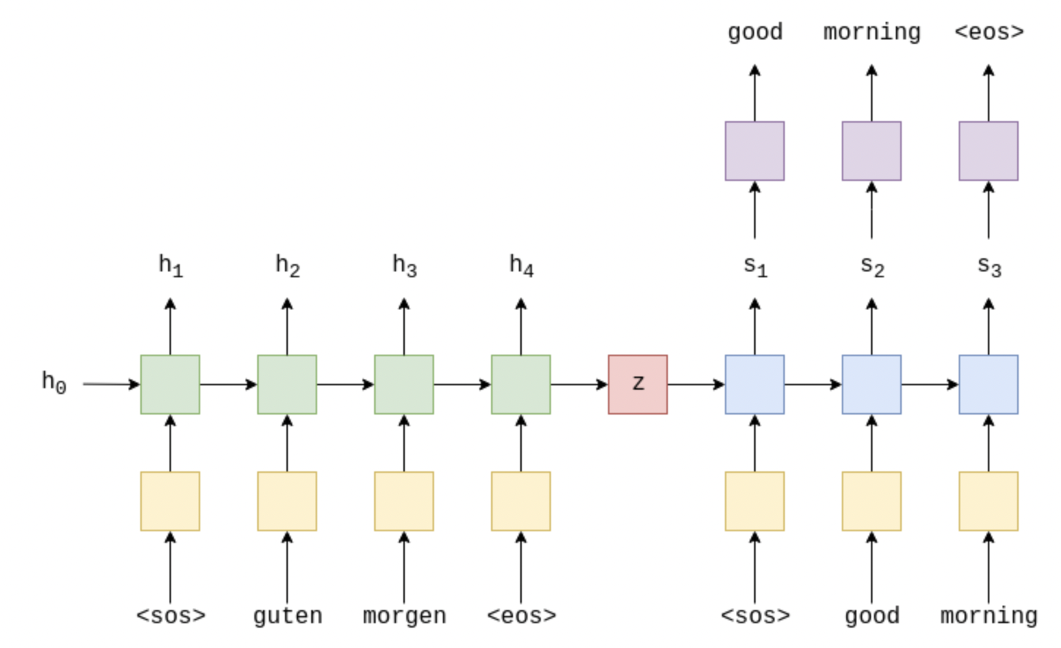
So… How does it work?
Seq2Seq architecture: input some sentences, encoded, add a context vector
Two parts: Encoder & Decoder
Encoder: Embedding Layer and Long Short-Term Memory (LSTM) units
Passes through encoder and receives output and tensors
Context vector is sent to the decoder and becomes its initial hidden/cell state

Slide 4
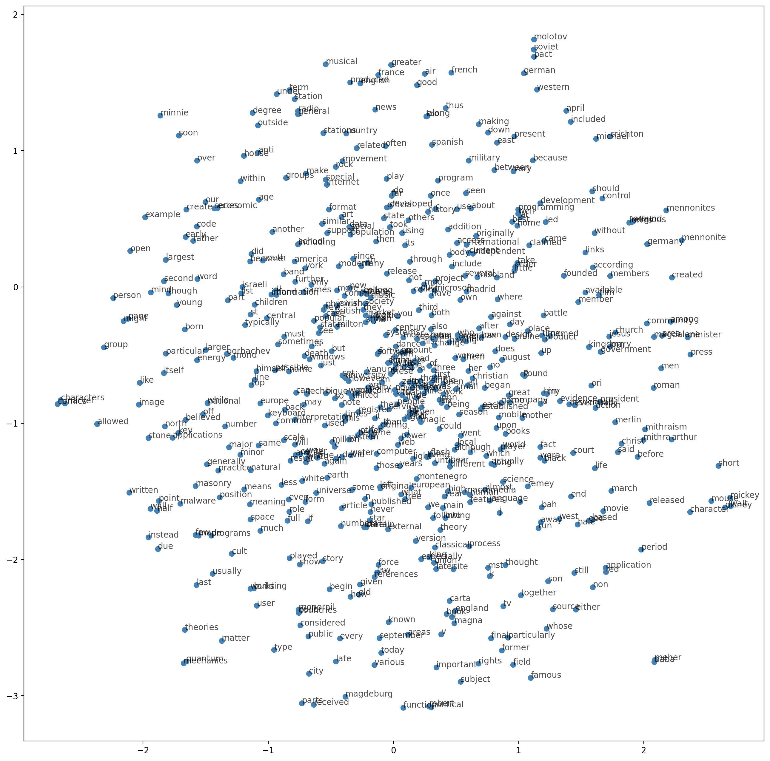
Word Embeddings

Slide 5
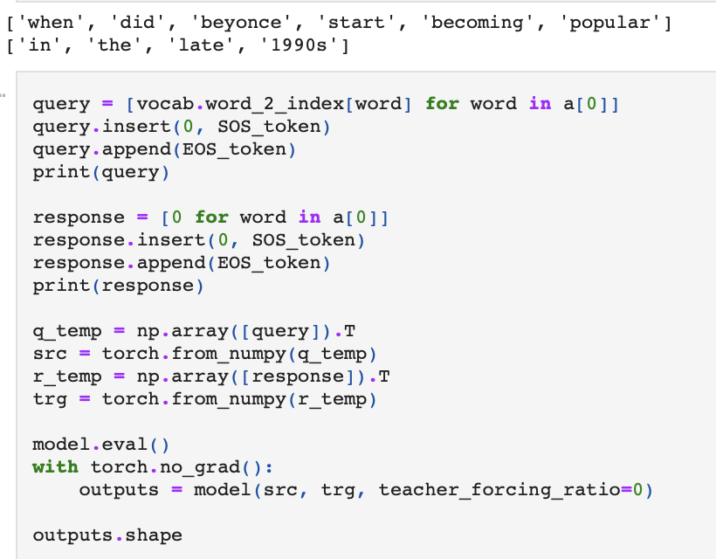
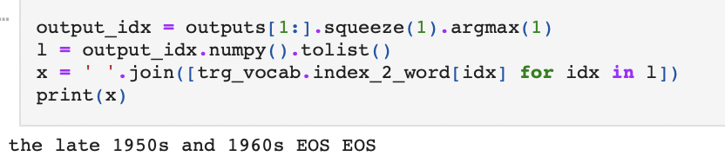
Example of Some Outputs

Slide 6
Benefits
Enhanced customer fulfillment: AI chatbots may respond to consumer inquiries quickly and accurately, enhancing overall customer satisfaction. Chatbots can assist clients in quickly resolving problems and obtaining the information they require by lowering wait times and offering 24/7 service.
Cost savings: By automating common actions and questions, chatbots can cut down on the requirement for human customer support agents and free up staff time for more complicated requests. Businesses may experience significant cost reductions as a result.
Enhanced productivity: Chatbots can respond to multiple user inquiries concurrently without the need for breaks or vacation time. In comparison to human agents, this indicates that they can offer a service that is more effective and reliable.

Slide 7
EVALUATION
Machine Learning
Deep Learning
How language models work
A few design decisions needed to be made
Can use word embeddings and change hyper parameters
Can use different optimizers
Different frameworks to use

Slide 8
Conclusion
AI chatbots are gaining popularity across industries and have substantial business and organizational potential
Chatbots can increase user satisfaction by quickly and accurately responding to user inquiries and automating repetitive operations, freeing up staff time for more complicated demands
Provides your business with a competitive advantage by providing a personalized, efficient, and effective customer service experience
We are confident that our solution can help you achieve your business goals and look forward to the opportunity to work with you.
Thank you for your consideration.

